Slide 1
The monolithic scenario, Microservices

Slide 2


Slide 3
What is Monolithic Architecture?
The Monolithic Architecture is regarded as the conventional method of application development. An application in Monolithic architecture is developed as a single package. The development of a normal application starts with modular layered or hexagonal architecture. This architecture is made up of different types of layers as follows:
Presentation Layer: The Graphic User Interface layer handles the Hypertext Transfer Protocol (HTTP) requests using HTML or XML/JSON.
Business Logic Layer: The business logic of the application is present in this layer.
Database Access Layer: All the database accesses, including both SQL and NoSQL, of the applications, happens in this layer.
Application Integration Layer: All software integrations with other systems happen in this layer.
Even though Monolithic Architecture has a logical layered architecture, the final applications will be packaged into a single monolith and then deployed. Monolithic applications lack proper modularity, and it has only a single code base.

Slide 4
What is a Microservice Architecture?
On the other hand, Microservice architecture follows a modular approach to develop various applications.
A Microservice Architecture comprises a set of small, independent, and autonomous modules which does various services.
Every service should have the capability of independent implementation of its corresponding business units. Monolithic architecture is a single unit.
But the Microservice architecture has a group of small independent units, which collectively works as a single application.
The whole functionalities of an application are broken into separate and independent deployable modules that talk to each other by methods called Application Programming Interfaces (APIs).
Each of the services in a Microservices architecture can be independently scaled, deployed, and updated easily.
The Microservice architecture is loosely-coupled; each component is independent with respect to the other.
Multiple programming languages can be used for coding them. Also, they can use a different storage type for data storage.

Slide 5
Key Differences Between Microservice vs Monolithic
1. Commitment to Technology
Microservice:
The advantage of developing an application that follows Microservices architecture is that developers have a wide variety of options for various technologies like operating systems, frameworks, programming languages, etc., for building an application.
Continual commitment and dependency can be eliminated using a single stack of technology.
A better and a new stack of technology can be adopted whenever new services are built, or existing services are updated.
Dependencies of the development team on resources to build or to update services are eliminated.
Monolithic:
In Monolithic architecture, developers are forced to use only one technology, no matter whatever its limitations are.
For example, when your application’s framework is outdated, migration to a new, better framework will be very difficult and challenging.
In such situations, developers should rewrite the whole application in a different programming language and on a new framework, making it riskier and more time-consuming.

Slide 6
2. Isolation of Faults
Microservice: Even if there is an error in any of the processes, the rest of the processes will be unaffected and can be run as all the services are independent and isolated from each other.
Monolithic: On the contrary, in Monolithic architecture, any kind of misbehavior in any of the components may severely affect the working of the entire application.
3. Management of Code
Microservice:
On the other hand, Microservice has a divided codebase.(Codebase is the complete source code required to maintain application functionality)
Codebases in microservices are broken into multiple code units, which makes them easy to manage and update.
Monolithic:
Monolithic code base sizes are huge.
Due to the large size of monolithic codebases, it is very difficult for development teams for understanding and managing it properly.
This further leads to the slowing down of the development processes.

Slide 7
4. Developments and Deployments are Continuous
Microservice:
Development, deployment, operation, and scaling of every component of Microservices application are independent.
Any update in any services of the application will not affect any other services.
Also, there is no sharing of implementation or codebase between services.
This leads to the ease of continuous development and the deployment of complex and huge applications.
Monolithic:
Its codebases are large, and the components are interdependent.
This leads to the limitation of continuous deployment and development because a complete application must be redeployed to update any component.
It is risky and affects all the background tasks, and connected service functions are also impacted.

Slide 8
5. Scaling of Application
Microservice:
All the services of Microservices applications are built as different modules.
This leads to the team’s division to different work, which further helps them change and update production easily.
This makes the scaling of application easier.
Monolithic:
The scaling of monolithic architecture applications is a challenge to developers as it is a single package unit.
The developers can’t work on separate modules.
If it is possible, heavy coordination will be required during deployment and development.

Slide 9
Difference Between Microservices vs Monolithic
Microservice vs Monolithic is the comparison between two standard approaches or architecture for software design and development.
Microservice is a present trend in the software industry that utilized some of the latest technologies and programming languages for software development. Whereas monolithic is an industry-standard approach that is implemented for several years.
Microservice architecture based applications can be implemented with multiple programming languages as independent services.
Whereas the monolithic application is based upon a single programing language. Microservice is known for its change adaptability and scalability.
Whereas monolithic apps are less scalable and change requires rebuilding the whole application code and redeployment.

Slide 10
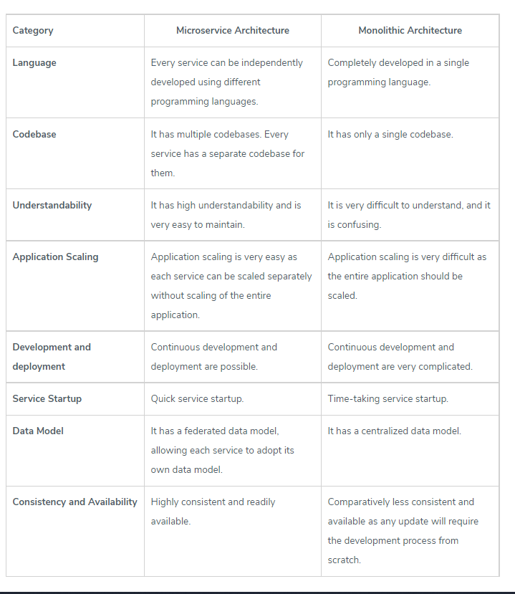
Microservice vs Monolithic Comparison Table

Slide 11
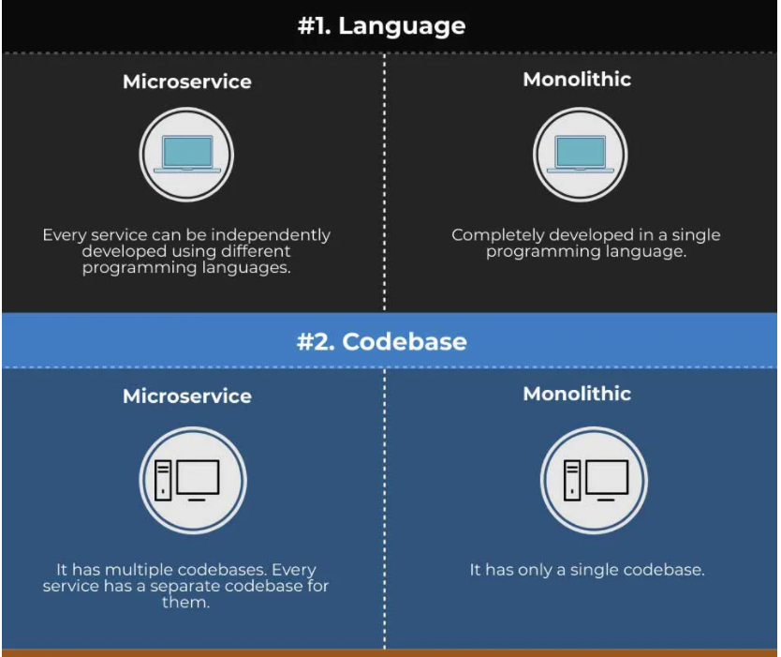

Slide 12
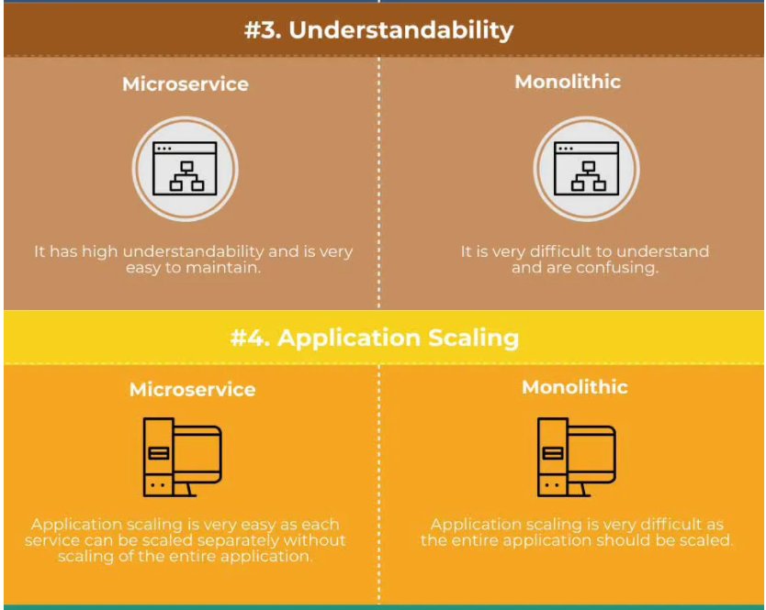

Slide 13
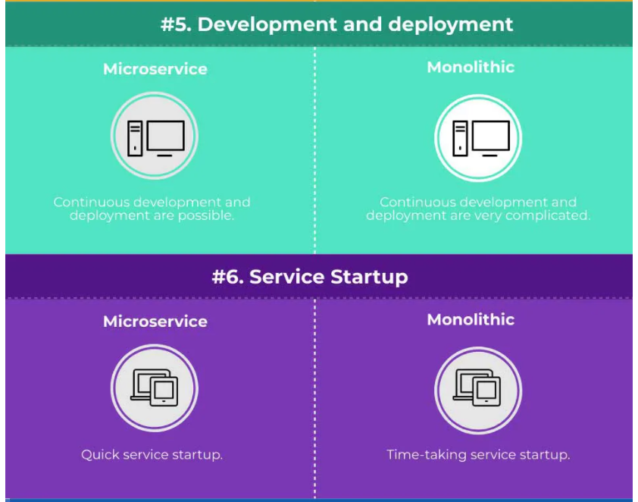

Slide 14
